Slide 1

GROUPONE
BY:: OM SHANKAR SAH
USN:1NH19CS116

Slide 2


INTRODUCTION
Moving towards twenty first century, where technology and development has taken an everyday growth has changed world from an actual to a virtual living. A virtual world is a computer simulated environment, which may be populated by many users who can create and independently explore the virtual world and also participate in its activities. From the food we eat, the clothes we wear and the insurances we take everything has come under a single click. The actual drawbacks set at the virtual world is that its timing consuming as it requires different apps to be maintained for different functionalities.

Slide 3
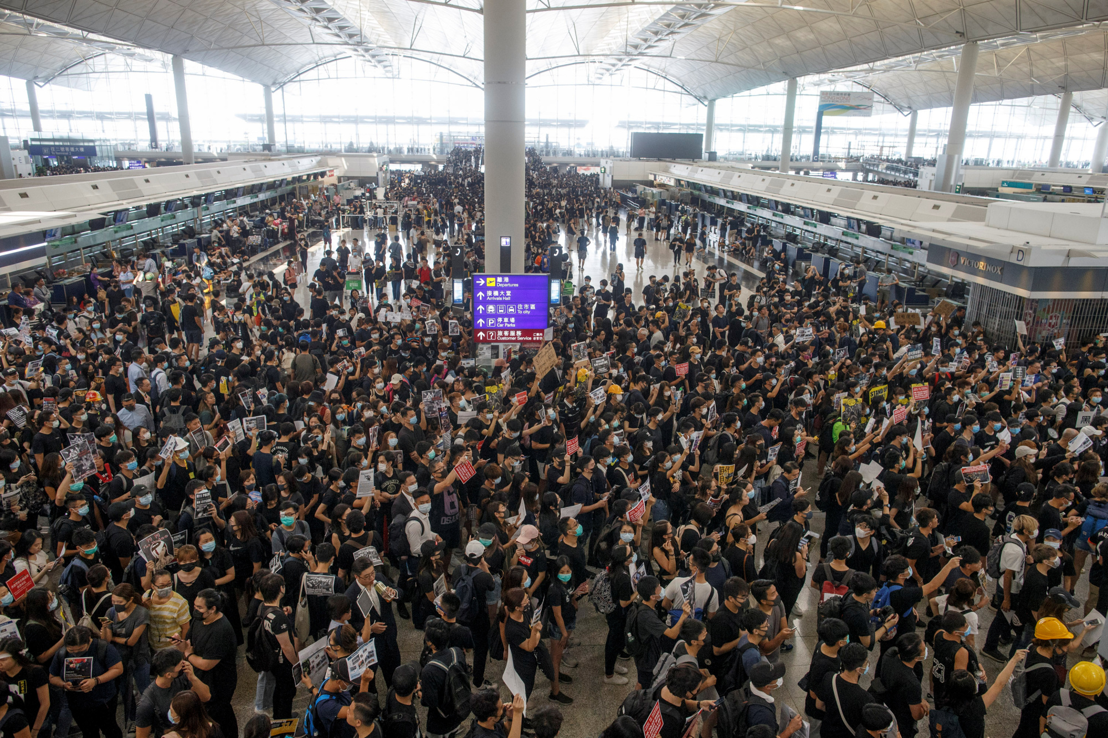

Nowadays, there is a problem of searching anything in different different platforms or domain’s we can search it on single domain or websites. When it comes to website management tools for online business, the industry is always changing. This project is based on giving the multiple option to one website, such as reading news, playing games, shopping and many more. It helps user to surf all the useful things in a single domain website. The bottom line is – multi things management on one platform can be done for business, brands, and even individual bloggers and content creators who want to have more control. It will also have login and register for security purpose and the review of the customers about the website and many options will be added further.

Slide 4

REQUIREMENTS
Hardware and Software Requirements:
PROCESSOR: Intel Pentium based system Processor
SPPED: 250 MHz to 833MHz RAM
SPEED: 2GB
Software Requirements:
HTML
NOTEPAD
CHROME
Operating System: Windows XP/10

Slide 5

EXPECTED OUTCOMES:
Using this project, we can:
Security login: This option allows to add security login into their account with specific
username and password. If the pin code doesn’t work, it would pop up with an error
message.
Users can read latest news or blogs.
Look for the best online games available under any platform.
Hear songs or watch videos.
In addition, users can also provide their reviewers on the website.
Logout from their accounts successfully.

Slide 6
ALGORITHM
Start the program
Enter the username and the password
If tab 2:Here u can order different types of food
Select an option from the switch cases:
tab1: playing games
tab2: ordering food
tab3:booking travel
tab4:news
Case5:entertainment
If tab1:Here u can play different types of gamed available
If tab 3:Here we can book different places to travel
If tab4:u can read the latest news and blogs.
If tab 5: it allows u to download different types of movies or watch it online
Stop the program

Slide 8

RESULTS
FIRST CLASS BOOKING:

Slide 9


Slide 10


THANK YOU
THANK YOU☺

